Slide 1
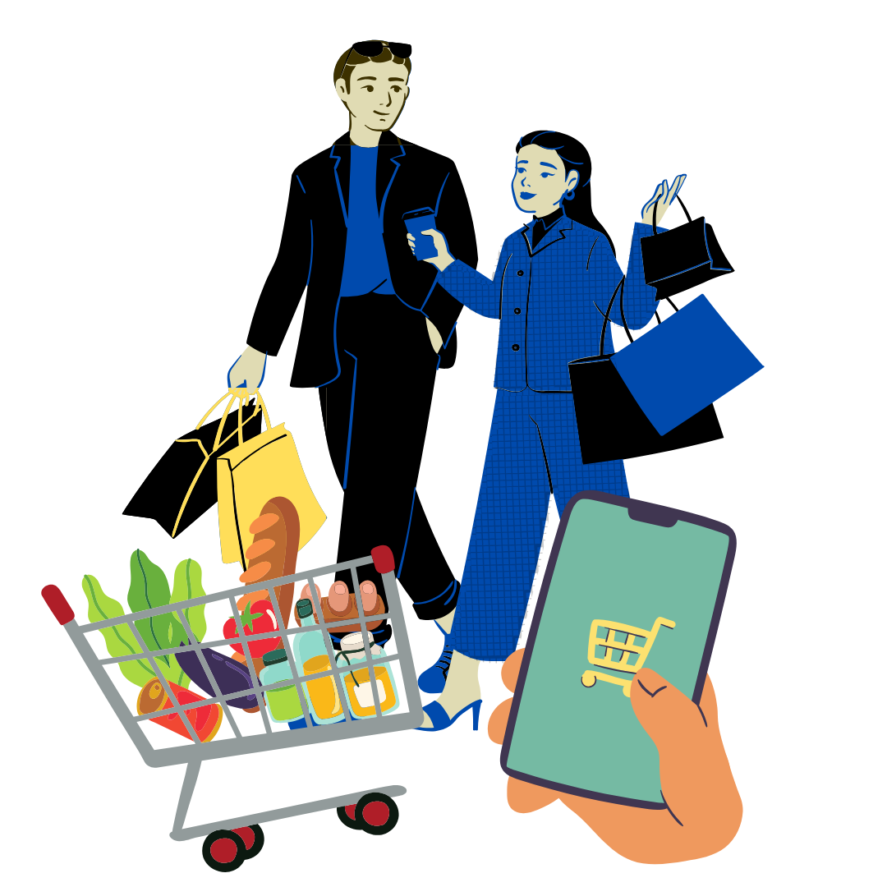
Unit 2
Lesson 2: I need your help to go shopping.

Slide 2
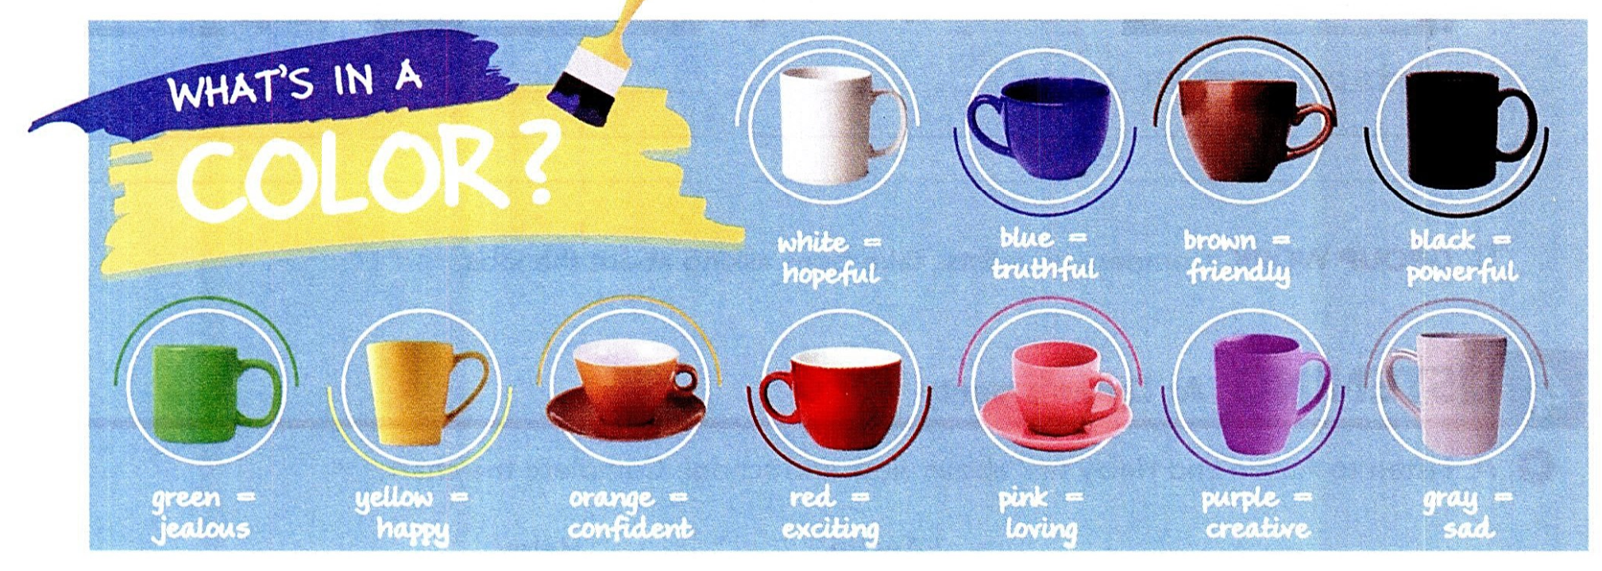
The meaning of colors
What is your favorite color?
Do you think colors reflect personality?
Does your favorite color show your personality (according to the meaning shown on the image)?

Slide 3
Record your conversation with a classmate. Send it to the WhatsApp group chat.

Slide 5
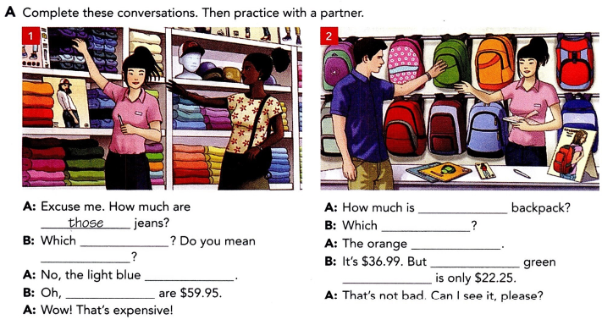

Slide 6
Record your conversation with a classmate. Send it to the WhatsApp group chat.

Slide 7
Notes:
CD 1, Track 24

